Slide 1
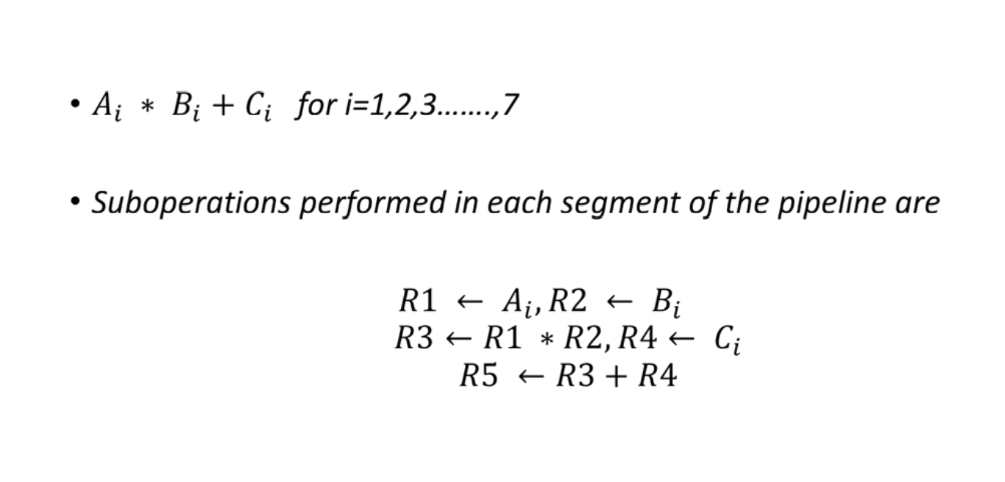
Pipelining:-
• Pipelining is a technique of decomposing a sequential process into suboperation with each subprocess being executed in a special dedicated segment that operates concurrently with all other segments.

Slide 2
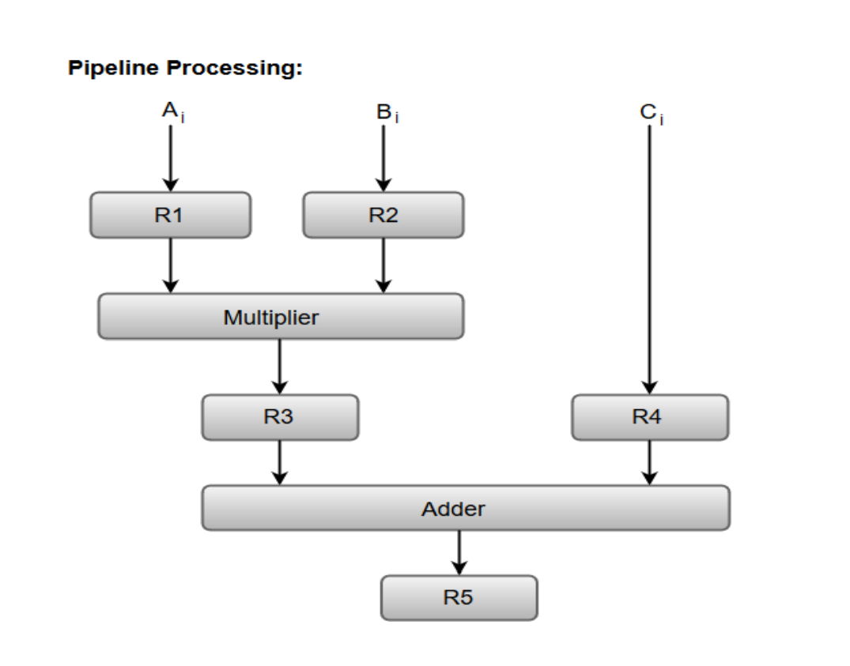

Slide 3
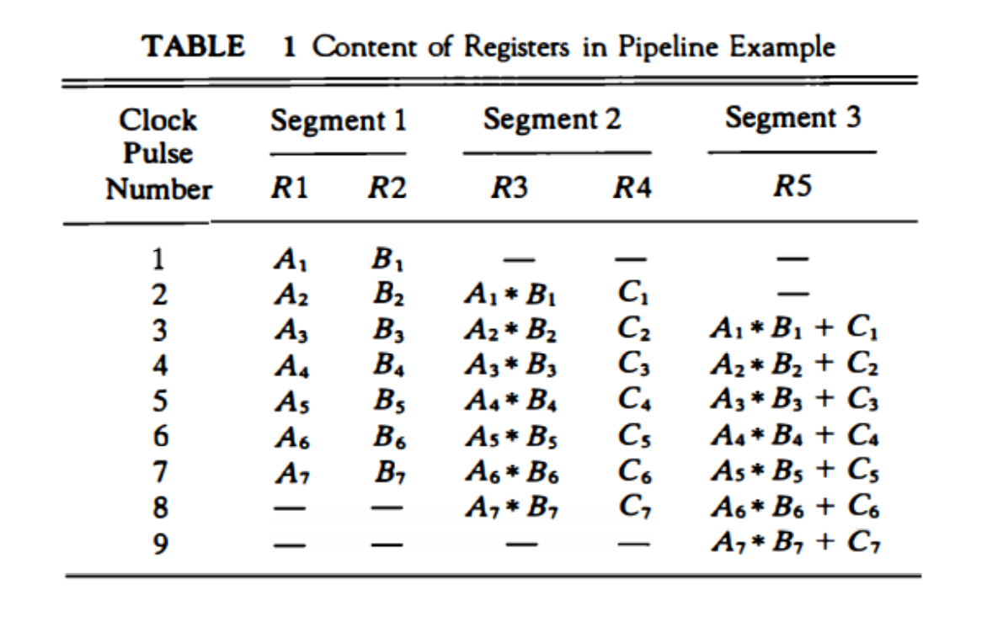

Slide 4
Parallel Processing:-
• The purpose of parallel processing is to speed up the computer processing capability and increase its throughput that is, the amount of processing that can be accomplished during a given interval of time. • The amount of hardware increases with parallel processing. The cost of the system increases. • However, technological developments have reduced hardware costs to the point where parallel processing techniques are economically feasible.
Classification of Parallel Processing:
• According to M.J.Flynn the classification of parallel Processing is :
• Single Instruction stream, single data stream (SISD).
• Single Instruction stream, multiple data stream (SIMD).
• Multiple Instruction stream, single data stream (MISD).
• Multiple Instruction stream, Multiple data stream (MIMD).

Slide 5
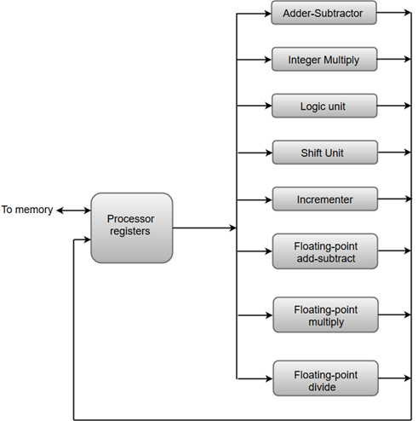

Slide 6
Single Instruction stream, single data stream (SISD):-
• SISD represents the organization of a single computer containing a control unit, a processor unit and a memory unit.
• Instructions are executed sequentially and the system may or may not have internal parallel processing capabilities.
• Parallel processing in this case may be achieved by means of multiple functional units or by pipeline processing.

Slide 7
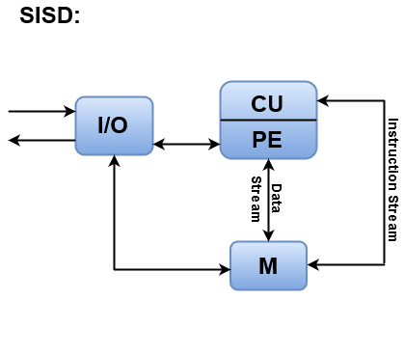
Where, CU = Control Unit, PE = Processing Element, M = Memory
Instructions are decoded by the Control Unit and then the Control Unit sends the instructions to the processing units for execution.
Data Stream flows between the processors and memory bi-directionally.
Examples:
Older generation computers, minicomputers, and workstations

Slide 8
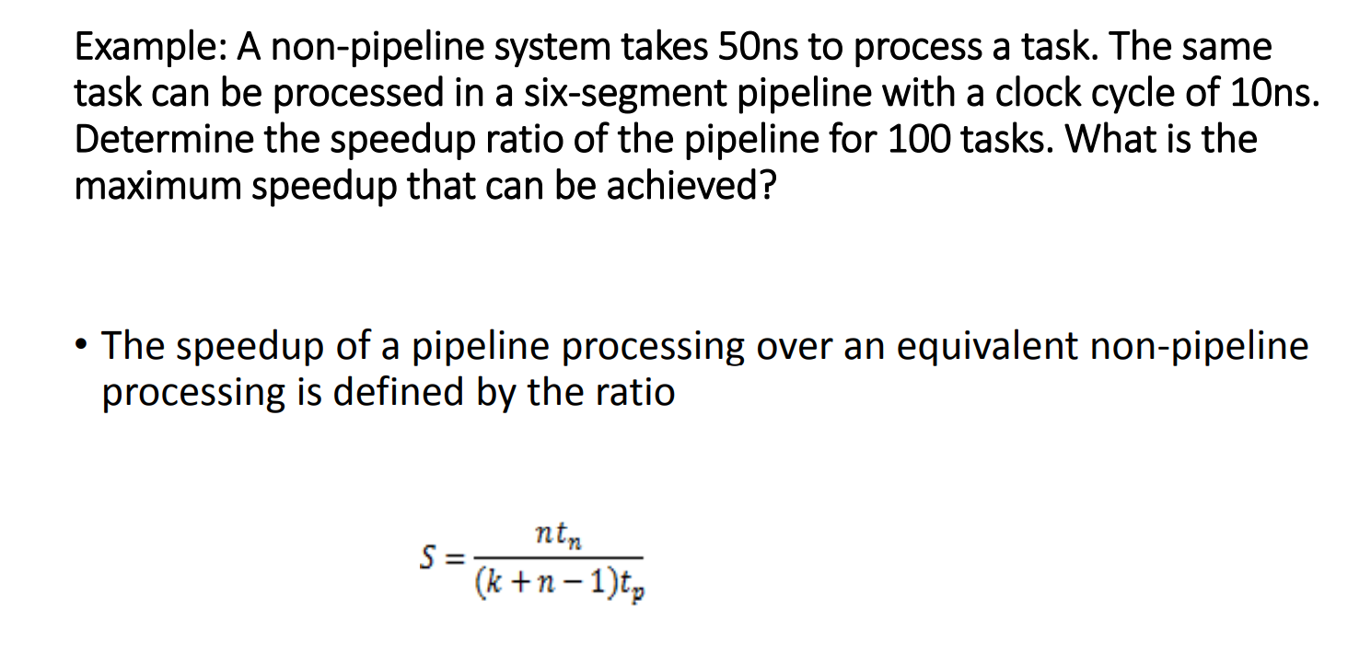

Slide 9
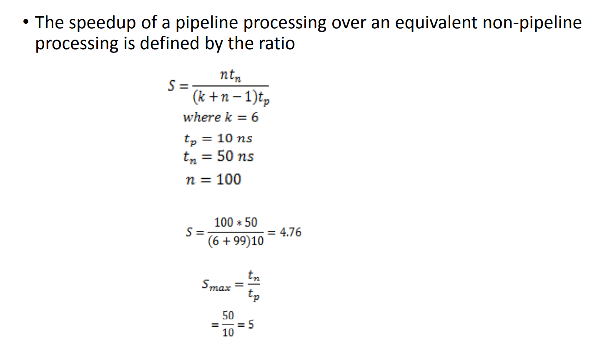

Slide 10
Arithmetic Pipeline:-
Arithmetic Pipelines are mostly used in high-speed computers. They are used to implement floating-point operations, multiplication of fixed-point numbers, and similar computations encountered in scientific problems.
To understand the concepts of arithmetic pipeline in a more convenient way, let us consider an example of a pipeline unit for floating-point addition and subtraction.
The inputs to the floating-point adder pipeline are two normalized floating-point binary numbers defined as:
X = A * 2ª = 0.9504 * 10³
Y = B * 2^{b} = 0.8200 * 10²
Where A and B are two fractions that represent the mantissa and a and b are the exponents.

Slide 11
The combined operation of floating-point addition and subtraction is divided into four segments. Each segment contains the corresponding suboperation to be performed in the given pipeline. The suboperations that are shown in the four segments are:
Compare the exponents by subtraction.
Align the mantissas.
Add or subtract the mantissas.
Normalize the result.

Slide 12
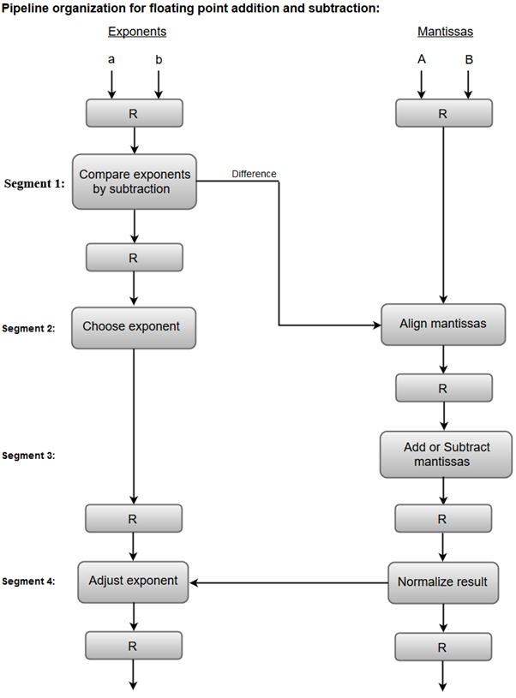

Slide 13
1. Compare exponents by subtraction:
The exponents are compared by subtracting them to determine their difference. The larger exponent is chosen as the exponent of the result.
The difference of the exponents, i.e., 3 - 2 = 1 determines how many times the mantissa associated with the smaller exponent must be shifted to the right.
2. Align the mantissas:
The mantissa associated with the smaller exponent is shifted according to the difference of exponents determined in segment one.
X = 0.9504 * 10³
Y = 0.08200 * 10³

Slide 14
3. Add mantissas:-
The two mantissas are added in segment three.
Z = X + Y = 1.0324 * 10³
4. Normalize the result:
After normalization, the result is written as:
Z = 0.1324 * 10⁴

Slide 15
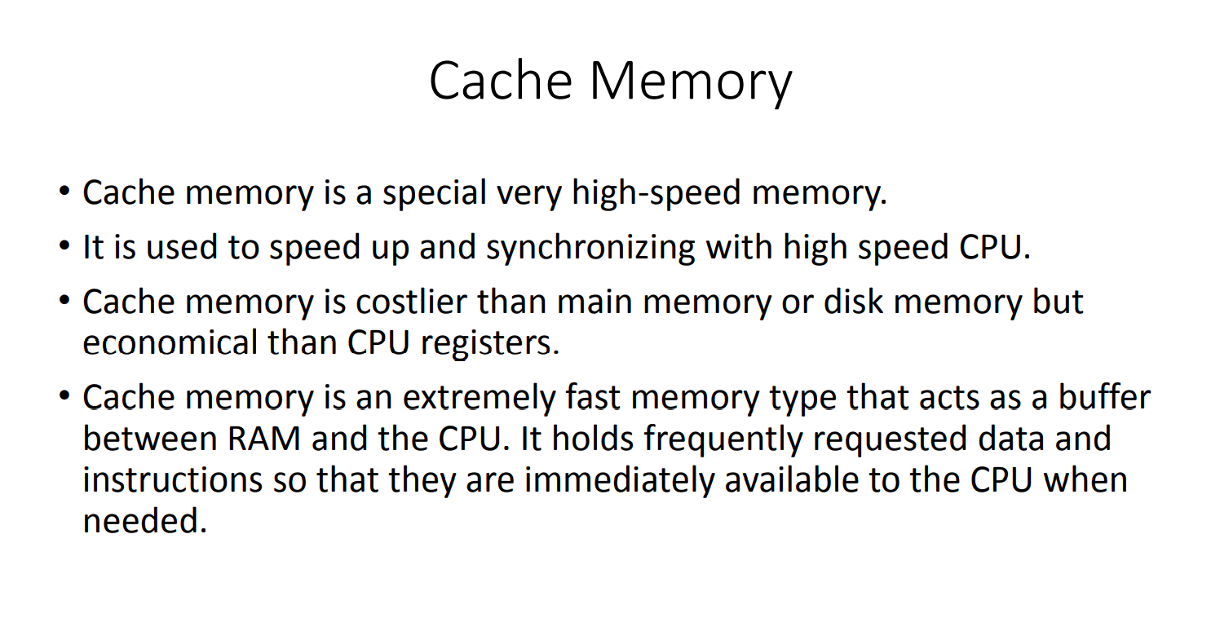

Slide 16
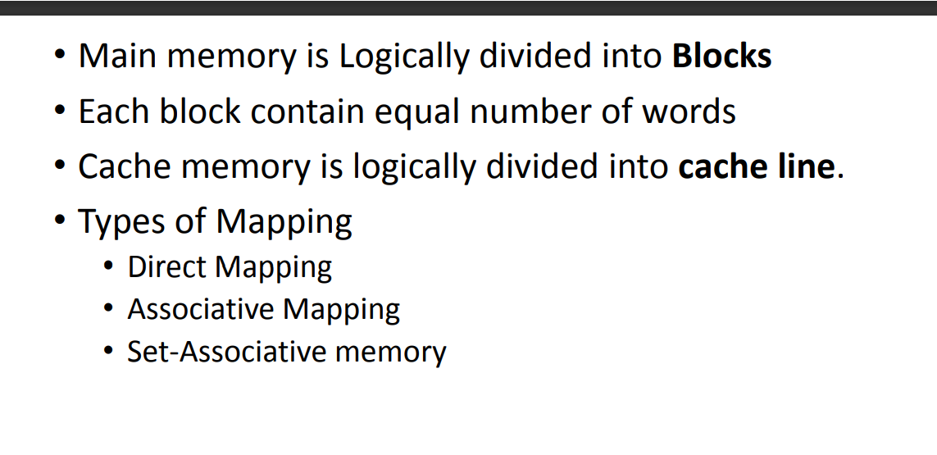

Slide 17
Memory Organization:-
The memory is organized in the form of a cell, each cell is able to be identified with a unique number called address. Each cell is able to recognize control signals such as “read” and “write”, generated by CPU when it wants to read or write address. Whenever CPU executes the program there is a need to transfer the instruction from the memory to CPU because the program is available in memory. To access the instruction CPU generates the memory request.
Memory Request: Memory request contains the address along with the control signals. For Example, When inserting data into the stack, each block consumes memory (RAM) and the number of memory cells can be determined by the capacity of a memory chip.

Slide 18
Hierarchical Memory Organization:-
The total memory capacity of a computer can be visualized by hierarchy of components. The memory hierarchy system consists of all storage devices contained in a computer system from the slow Auxiliary Memory to fast Main Memory and to smaller Cache memory.
Auxillary memory access time is generally 1000 times that of the main memory, hence it is at the bottom of the hierarchy.
The main memory occupies the central position because it is equipped to communicate directly with the CPU and with auxiliary memory devices through Input/output processor (I/O).
When the program not residing in main memory is needed by the CPU, they are brought in from auxiliary memory. Programs not currently needed in main memory are transferred into auxiliary memory to provide space in main memory for other programs that are currently in use.
The cache memory is used to store program data which is currently being executed in the CPU. Approximate access time ratio between cache memory and main memory is about 1 to 7~10

Slide 19
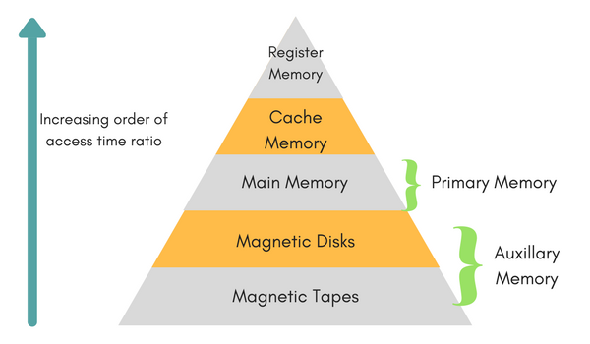

Slide 20
Cache Size:- It seems that moderately tiny caches will have a big impact on performance.
Block Size:- Block size is the unit of information changed between cache and main memory.
As the block size will increase from terribly tiny to larger sizes, the hit magnitude relation can initially increase as a result of the principle of locality. The high chance that knowledge within the neck of the woods of a documented word square measure possible to be documented within the close to future. As the block size increases, a lot of helpful knowledge square measure brought into the cache.
The hit magnitude relation can begin to decrease, however, because the block becomes even larger and also the chance of victimization the new fetched knowledge becomes but the chance of reusing the information that ought to be abstracted of the cache to form area for the new block.

Slide 21
Mapping Function:-
When a replacement block of data is scan into the cache, the mapping performs determines that cache location the block will occupy. Two constraints have an effect on the planning of the mapping perform. First, once one block is scan in, another could be replaced . We would wish to do that in such the simplest way to minimize the chance that we are going to replace a block which will be required within the close to future. A lot of versatile the mapping perform, a lot of scopes we’ve to style a replacement algorithmic rule to maximize the hit magnitude relation. Second, a lot of versatile the mapping perform, a lot of advanced is that the electronic equipment needed to look the cache to see if a given block is within the cache.

Slide 22
Replacement Algorithm:-
The replacement algorithmic rule chooses, at intervals, the constraints of the mapping perform, which block to interchange once a replacement block is to be loaded into the cache and also the cache already has all slots full of alternative blocks. We would wish to replace the block that’s least possible to be required once more within the close to future. Although it’s impossible to spot such a block, a fairly effective strategy is to interchange the block that has been within the cache longest with no relevance. This policy is spoken because of the least-recently-used (LRU) algorithmic rule. Hardware mechanisms square measure required to spot the least-recently-used block

Slide 23
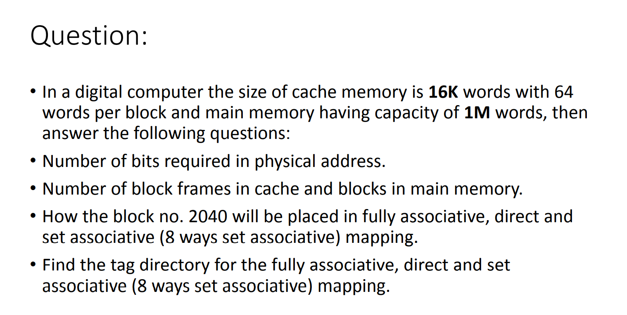

Slide 24
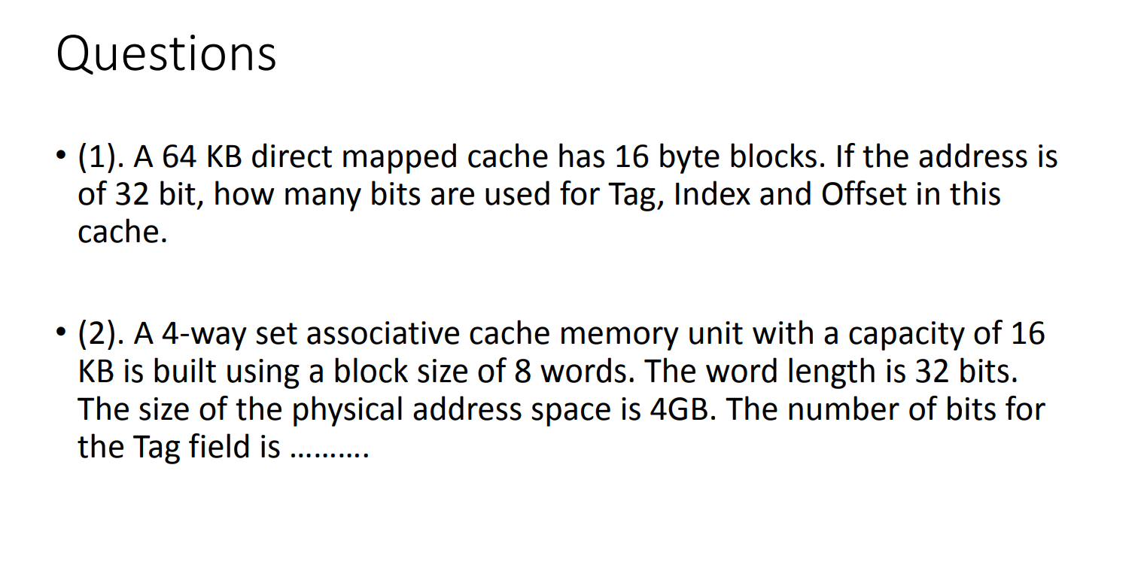

Slide 25
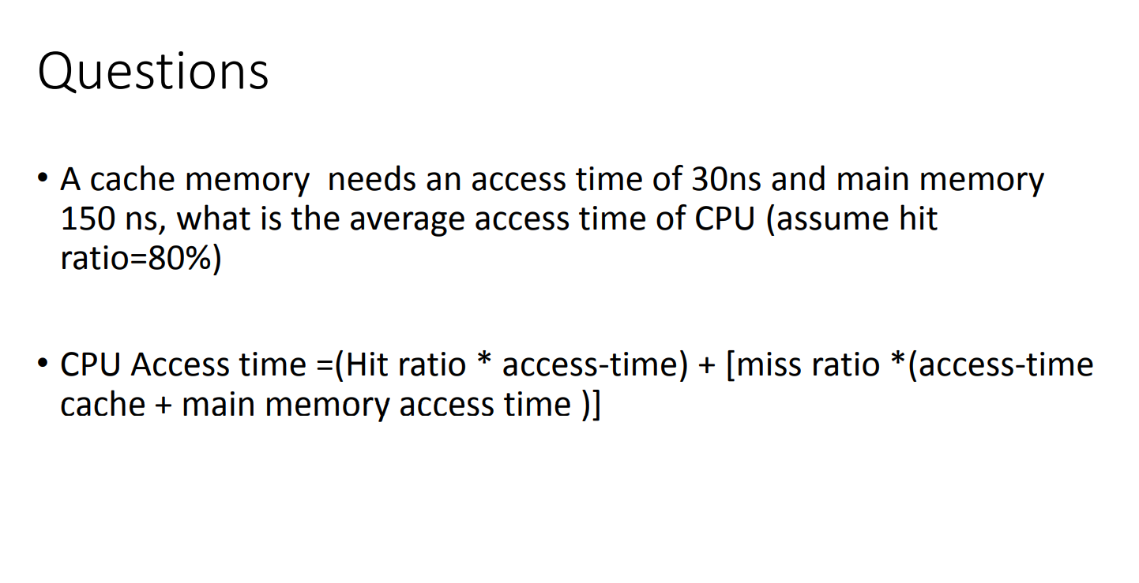

Slide 26
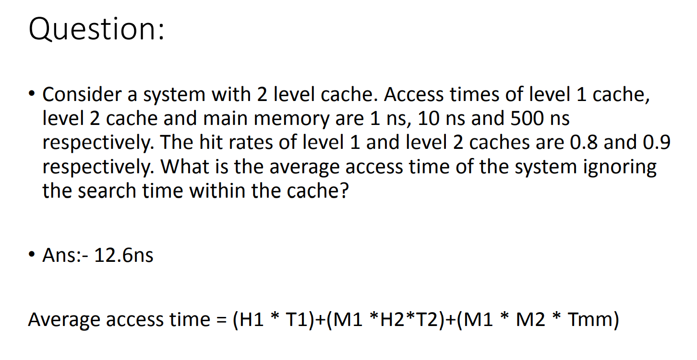

Slide 27
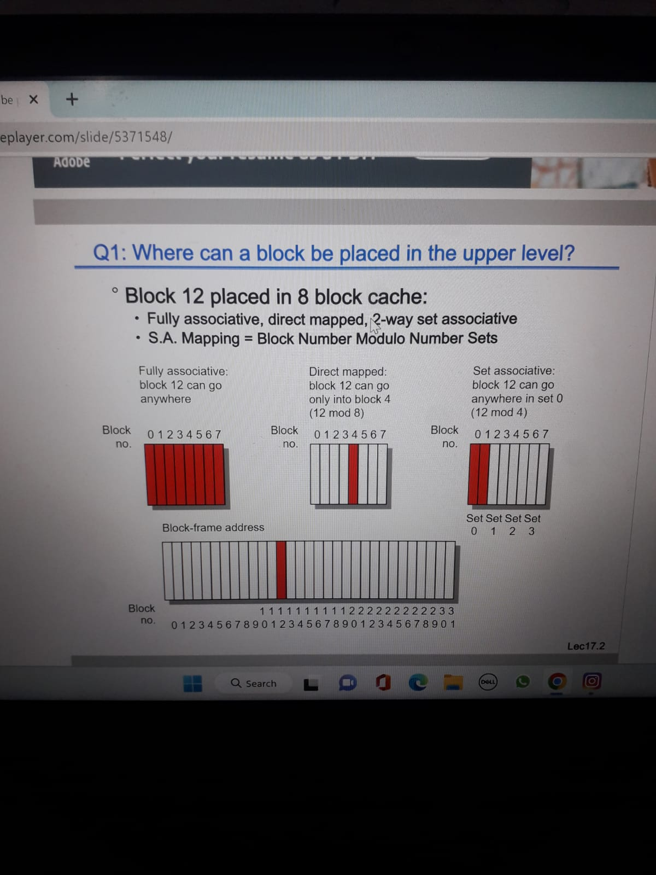

Slide 28
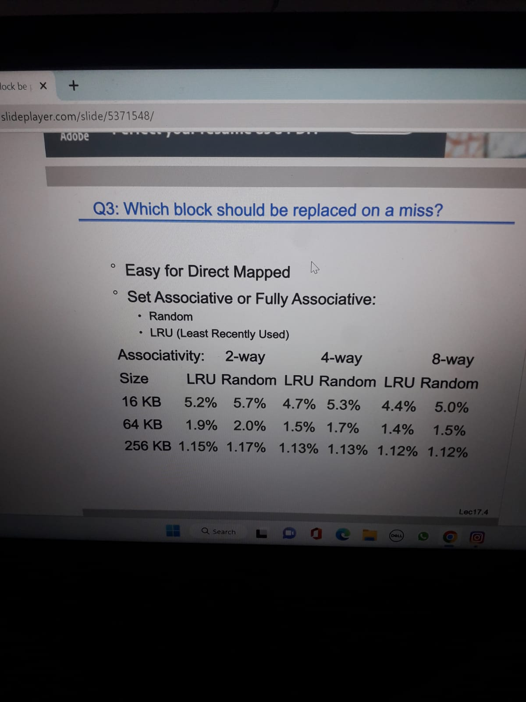

Slide 29


Slide 30
